Slide 1
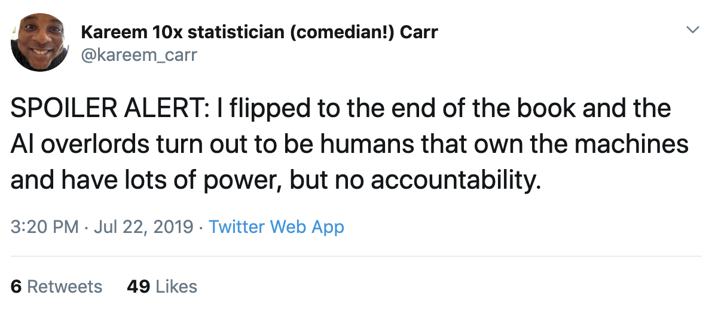

Slide 2
Thinking Critically about Data & Tech

Slide 3
Learning Objectives
Students will become familiar with & think critically about selected issues in Data Ethics
Privacy
Algorithmic Bias
High-Stakes Decision Systems
Students will be motivated to learn more and begin to monitor the news about these issues

Slide 4
My wife asked me why I speak so softly in the house.
I said I was afraid Mark Zuckerberg was listening.
She laughed.
I laughed.
Alexa laughed.
Siri laughed.

Slide 5
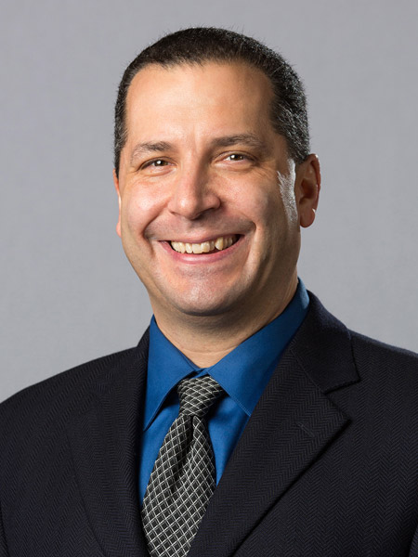
"...you tell people what you're going to collect, why you're going to collect it.
Use limitation; you only use the data for the purpose you collected it.
In the big data world that's turned on its head.
We don't know what we want to use the data for."
Sol Bermann Chief Privacy Officer University of Michigan
Notes:
https://er.educause.edu/multimedia/2019/7/ask-a-chief-privacy-officer?utm_source=Informz&utm_medium=Email&utm_campaign=ER#_zs7WcMe1_zlcBO06

Slide 6
#privacy

Slide 7
The “real” you
Data shared willingly
Data shared grudgingly
Data shared unknowingly
Data shared illegally
Your aggregated data
Data about peers
Predictions about you

Slide 8
The “real” you
Social Media
Data shared willingly
Likes
Data shared grudgingly
Data shared unknowingly
Posts
Data shared illegally
Does availability of data imply consent?
Your aggregated data
Data about peers
Predictions about you
Notes:
Data you share willingly (posts, likes)
Data you share grudgingly (dark patterns, coercion)
Data you share unknowingly (trackers, surveillance)
Data shared against your will (doxing, data breaches)
Data aggregated about you (data brokers, surveillant assemblage)
Data about people similar to you (
Models & Predictions about you (risk scores, emotions)

Slide 9
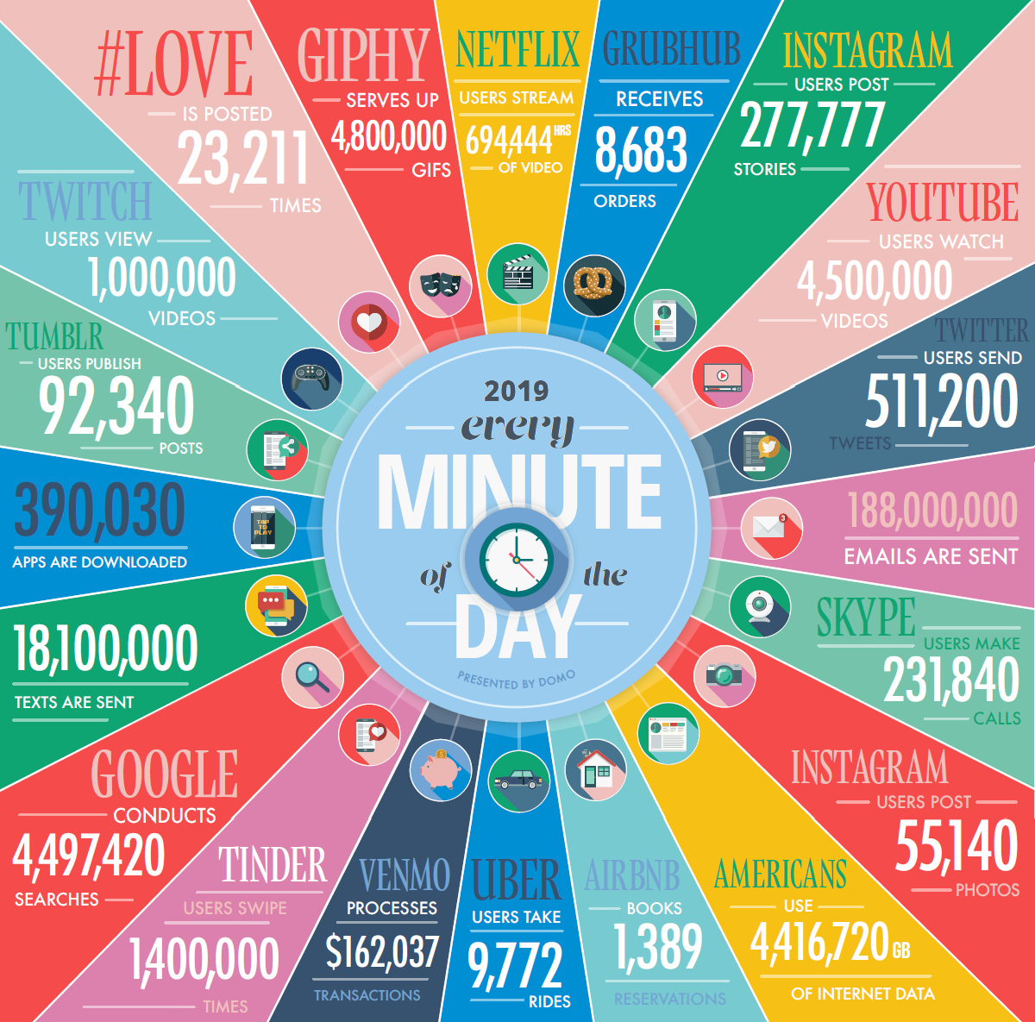
Notes:
https://www.visualcapitalist.com/big-data-keeps-getting-bigger/

Slide 10
The “real” you
Dark Patterns
Data shared willingly
Data shared grudgingly
Data shared unknowingly
T.O.S.
Data shared illegally
Your aggregated data
Is the ability to “opt out” distributed equally?
Data about peers
Predictions about you
Notes:
Terms of service
Roomba sharing maps of your home with their commercial clients.

Slide 11
The “real” you
Surveillance
Data shared willingly
Data shared grudgingly
Data shared unknowingly
Trackers
Data shared illegally
Data exhaust
Your aggregated data
Data about peers
What about consent?
Predictions about you
Notes:
Data you share unknowingly (trackers, surveillance)
Data shared against your will (doxing, data breaches)
Data aggregated about you (data brokers, surveillant assemblage)
Data about people similar to you (
Models & Predictions about you (risk scores, emotions)

Slide 12
The “real” you
Data Breach
Data shared willingly
Data shared grudgingly
Data shared unknowingly
Doxing
Data shared illegally
Your aggregated data
Data about peers
The (digital) “wild west”
Predictions about you
Notes:
Data you share unknowingly (trackers, surveillance)
Data shared against your will (doxing, data breaches)
Data aggregated about you (data brokers, surveillant assemblage)
Data about people similar to you (
Models & Predictions about you (risk scores, emotions)

Slide 13
The “real” you
“Surveillant assemblage”
Data shared willingly
Data shared grudgingly
Data shared unknowingly
brokers
Data shared illegally
Your aggregated data
Data about peers
Your “data double”
Predictions about you
Notes:
Data aggregated about you (data brokers, surveillant assemblage)
https://onlinelibrary.wiley.com/doi/abs/10.1080/00071310020015280
Data about people similar to you (
Models & Predictions about you (risk scores, emotions)

Slide 14
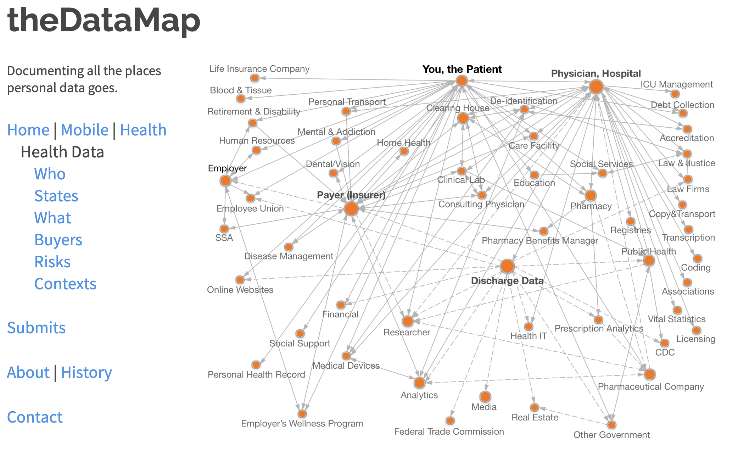
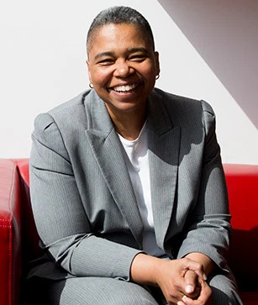
"87% of the U.S. population is uniquely identified by date of birth, gender, and postal code."
Latanya Sweeney, PhD
Notes:
https://thedatamap.org/map2013/p17.php

Slide 15
The “real” you
Machine learning
Data shared willingly
Data shared grudgingly
Data shared unknowingly
prediction
Data shared illegally
Your aggregated data
“People who liked X also liked Y”
Data about peers
Predictions about you
Notes:
Data about people similar to you (
Models & Predictions about you (risk scores, emotions)

Slide 16
The “real” you
Risk scores
Data shared willingly
Data shared grudgingly
Data shared unknowingly
emotions
Data shared illegally
Your aggregated data
Data about peers
Minority Report?
Predictions about you
Notes:
Models & Predictions about you (risk scores, emotions)

Slide 17
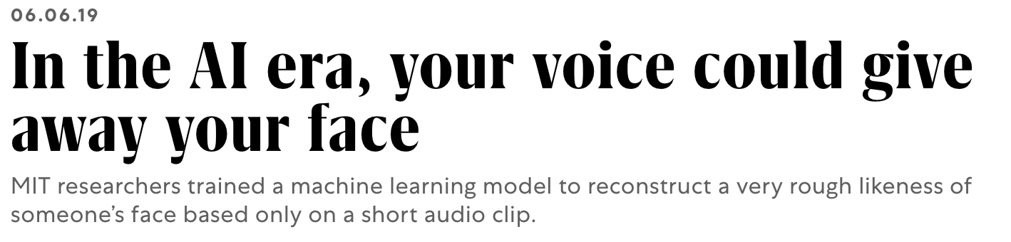
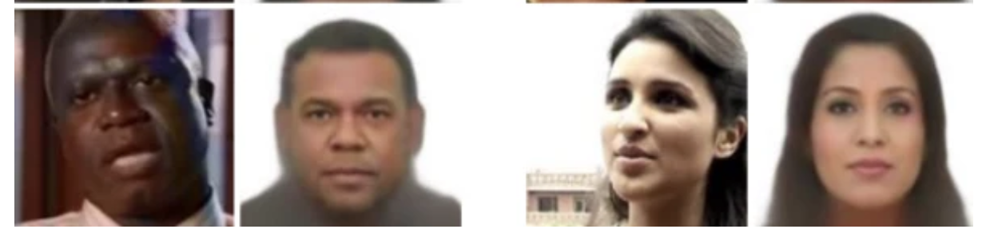
Notes:
https://www.fastcompany.com/90357561/this-ai-guesses-human-faces-based-only-on-their-voices?position=2&campaign_date=06232019

Slide 18

Surveillance is Digital Violence
Renee Cummings, UVA Data Activist in Residence
Notes:
https://www.singularityweblog.com/renee-cummings/

Slide 19
“If you have nothing to hide, you have nothing to fear.”
Solutions?

Slide 20
Individual
Caveat Emptor
Improve
If you are not paying for it, you’re not the customer; you’re the product being sold.
Solutions
Let the buyer beware
Awareness, Transparency

Slide 21
Technological
Faith in Tech
Improve
Solutions
There’s an APP for that!
Encryption, Blockers

Slide 22

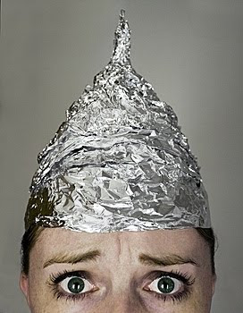
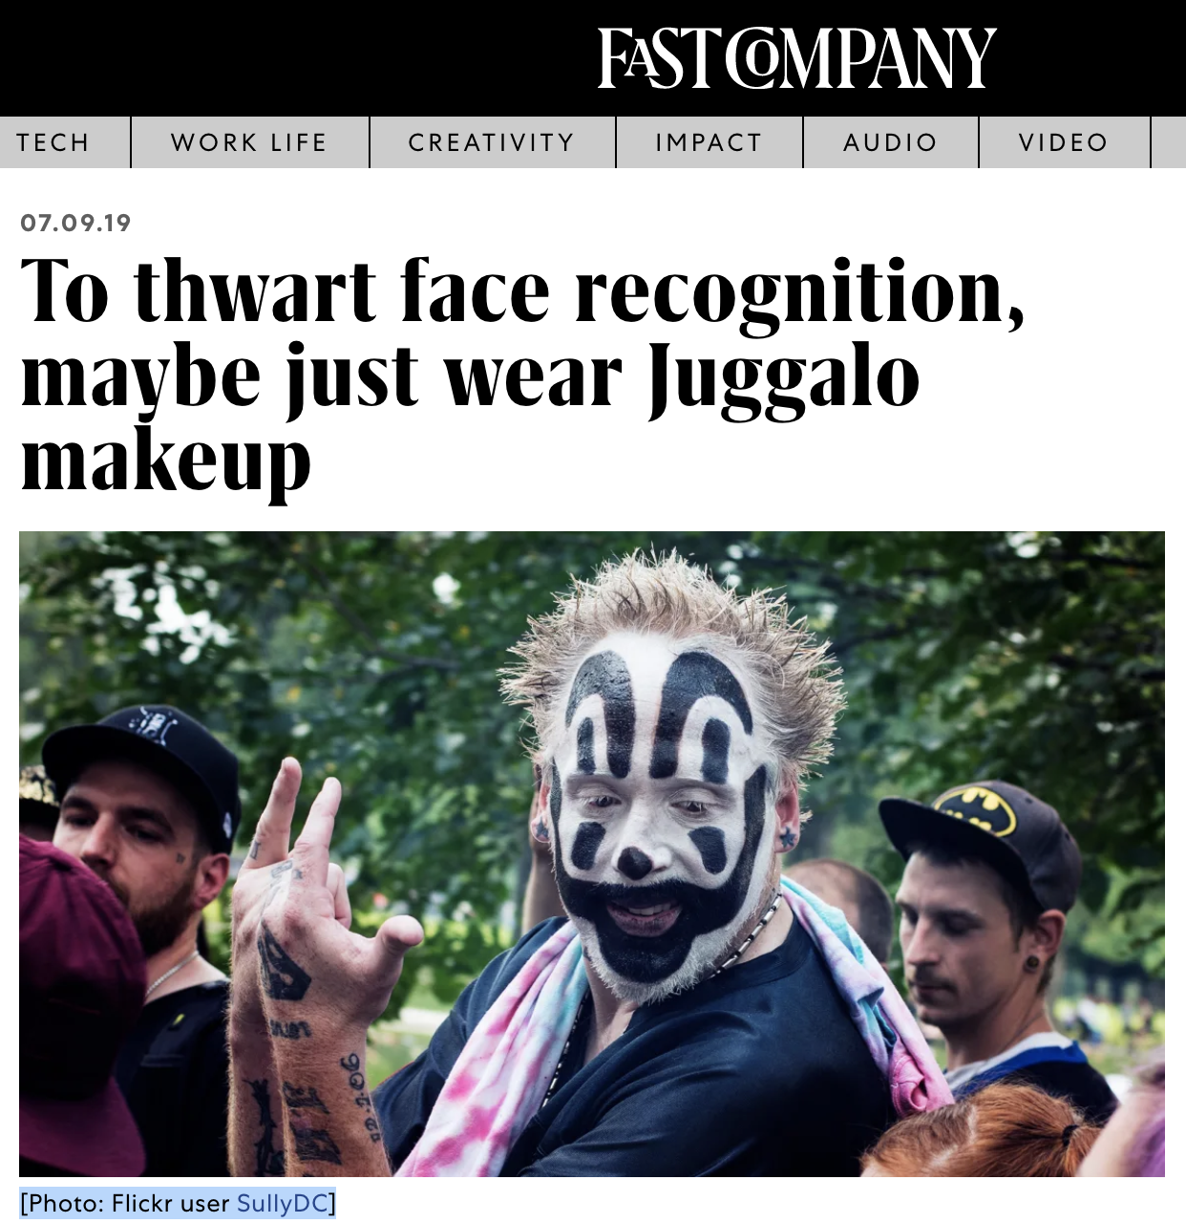

“There’s an APP for that”

Slide 23
Cultural
Interdisciplinary
Improve
Solutions
“CS students should study Humanities”
Education, Training

Slide 24
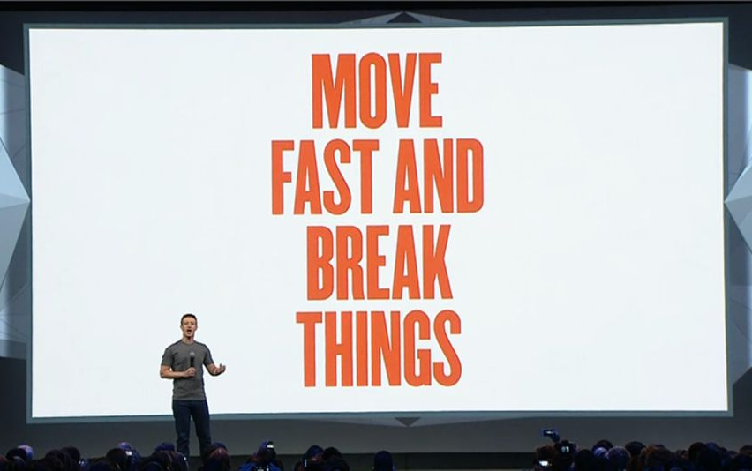
Big Tech: Let us regulate ourselves!
Also Big Tech:
Notes:
https://mashable.com/2014/04/30/facebooks-new-mantra-move-fast-with-stability/

Slide 25
Regulatory
Ban all the things
Improve
Solutions
Not in my Backyard
Oversight, Laws

Slide 26
Market
Invisible hand?
Improve
solutions
Pay me for my data
Incentive structures

Slide 27
Governance
Human Rights
Improve
solutions
I produce data, therefore I am
Legal Frameworks

Slide 28
#DataSovereignty

Slide 29

“Tribal nations recognize that their participation in biomedical research stands to benefit members of their community, but want to ensure that Tribal sovereignty, cultural beliefs and community values are respected and considered when collaborating in the research.”
David R. Wilson, Ph.D. on the signing of the data-sharing and use agreement between NIH and the Navajo people (May 2019)
Notes:
Navajo Nation signs data sharing agreement to advance uranium exposure research efforts http://www.navajo-nsn.gov/News%20Releases/OPVP/2019/may/FOR%20IMMEDIATE%20RELEASE%20-%20Navajo%20Nation%20signs%20data%20sharing%20agreement%20to%20advance%20uranium%20exposure%20research%20efforts.pdf
Tribal Data Sharing
and Genetics Policy
Development Workshop
https://dpcpsi.nih.gov/sites/default/files/dpcpsi/document/Meeting%20Summary_Tribal%20Genetic%20Research%20and%20Data%20Sharing%20Policy%20Workshop_508.pdf
https://www.sacnas.org/2019/05/22/tribal-data-sharing-agreement/
https://echochildren.org/nih-echo-and-the-navajo-nation-make-history-with-new-data-sharing-and-use-agreement/
https://allofus.nih.gov/about/who-we-are/tribal-collaboration-working-group-all-us-research-program-advisory-panel/david-r
https://dpcpsi.nih.gov/thro/directorsannouncement
https://allofus.nih.gov/about/who-we-are/tribal-collaboration-working-group-all-us-research-program-advisory-panel

Slide 30
#MachineBias

Slide 31
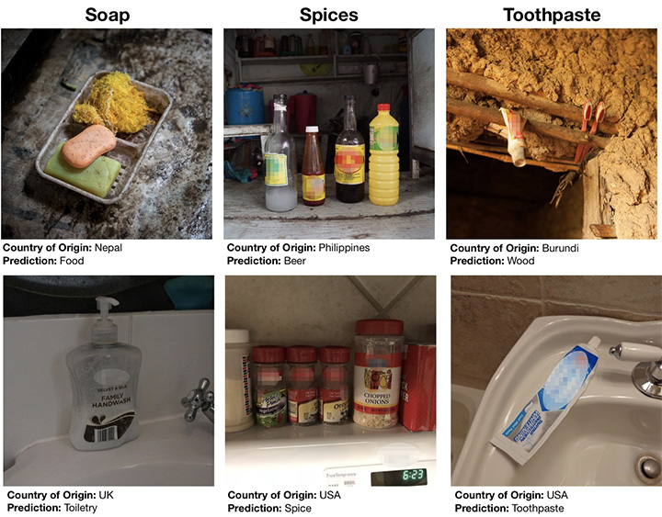
#Algorithmic Bias
Notes:
https://ai.facebook.com/blog/new-way-to-assess-ai-bias-in-object-recognition-systems/

Slide 32
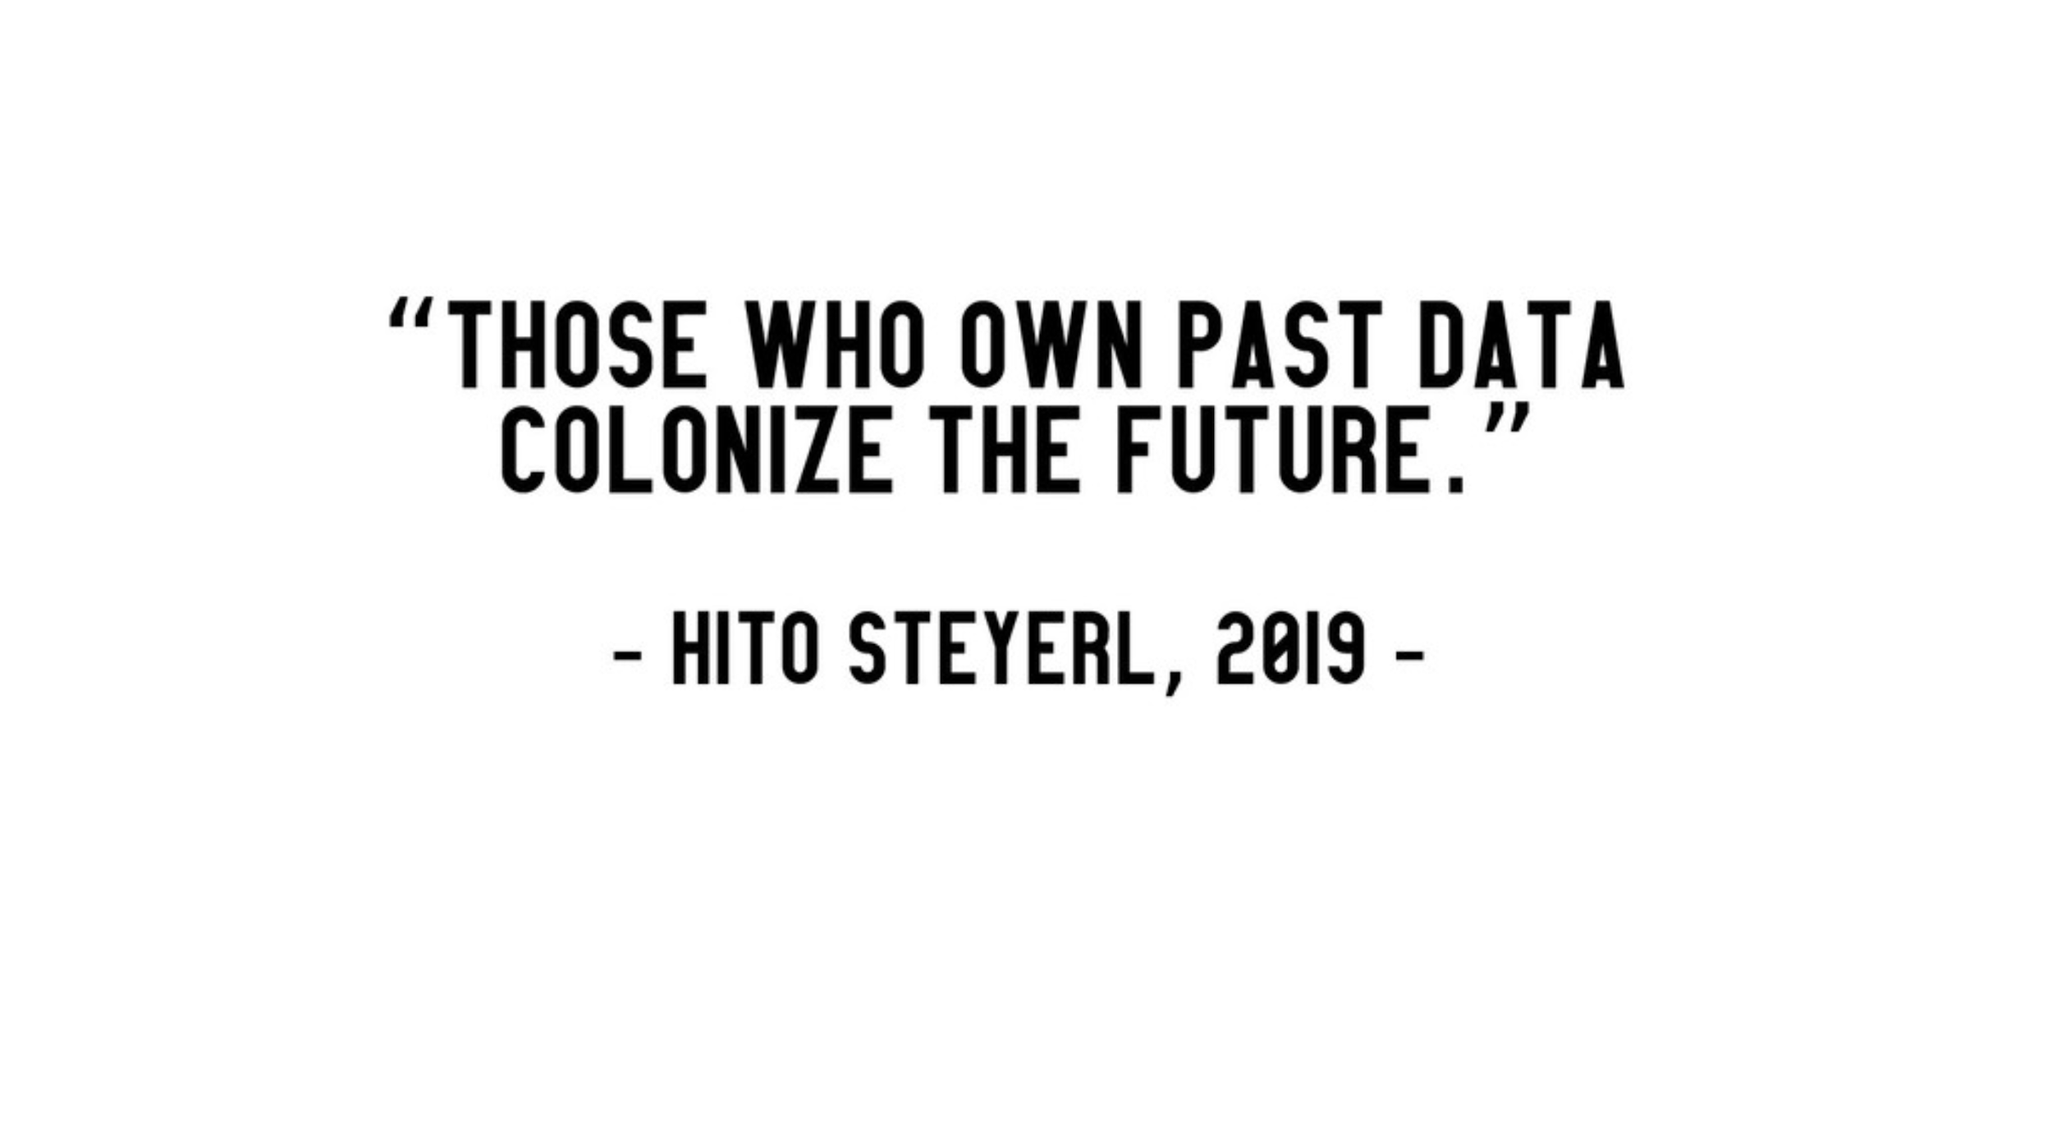
call +1 646 558 8656 and use meeting id 882 898 6179
Notes:
Laura Laugwitz
Hochschule für Technik und Wirtschaft Berlin | HTW · Institute of Computer Engineering

Slide 33
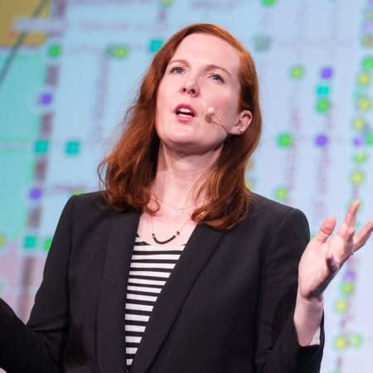
Artificial Intelligence
is neither Intelligent
nor Artificial
Kate Crawford, AI Now Institute
Notes:
https://www.theguardian.com/technology/2021/jun/06/microsofts-kate-crawford-ai-is-neither-artificial-nor-intelligent

Slide 34
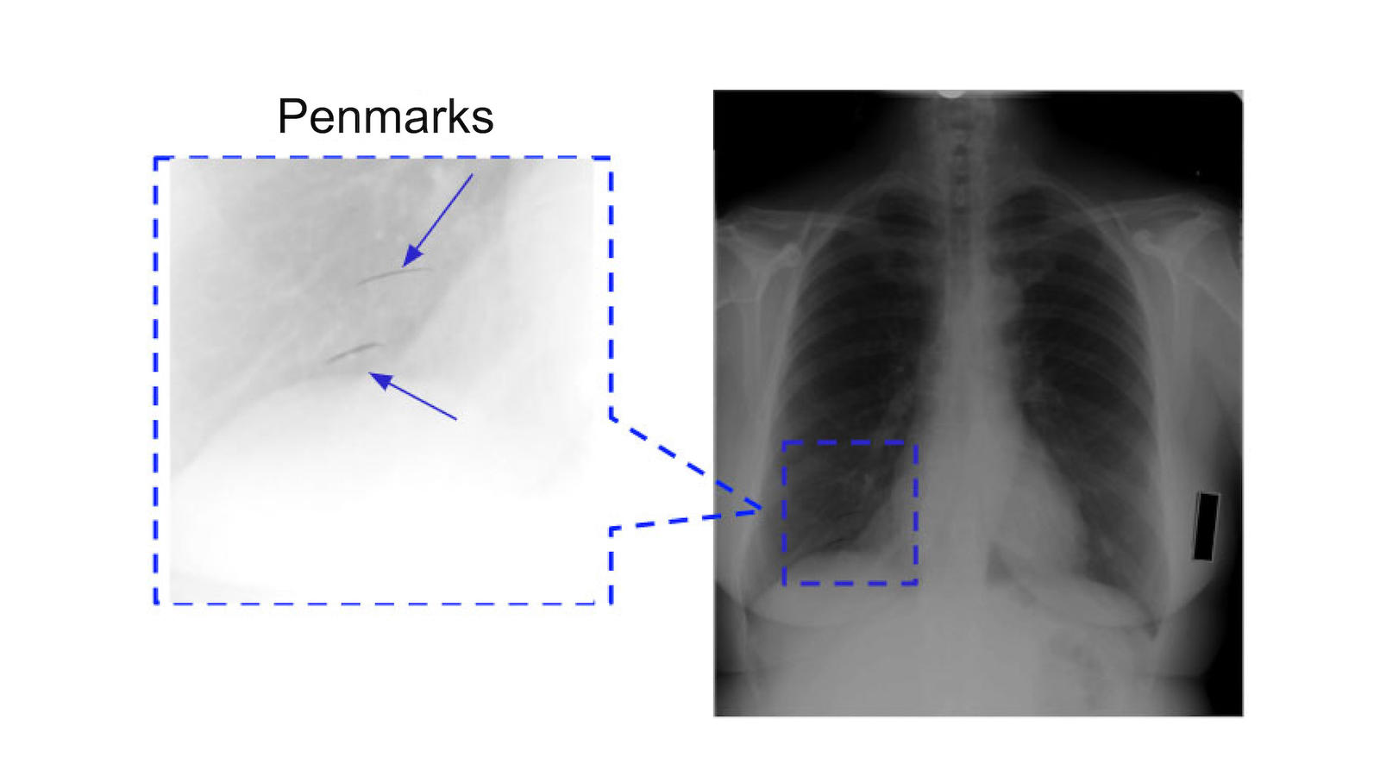
Dr. Mukund Sundararajan will speak at BI&I on June 15
Notes:
https://biocomplexity.virginia.edu/event/analyzing-deep-neural-networks-using-attribution
Wolves and dogs
https://arxiv.org/abs/1602.04938

Slide 35
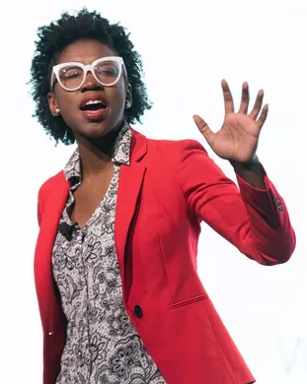
“We evaluate three commercial gender classification systems using our dataset and show that darker-skinned females are the most misclassified group (with error rates of up to 34.7%). The maximum error rate for lighter-skinned males is 0.8%.”
Gender Shades
Joy B: AI, Ain’t I a Woman?

Slide 36

Human actors can make biased decisions.
Algorithms can make biased decisions at scale.

Slide 37
High-Stakes Decision Systems

Slide 38
... in the labor market
Who will see this job ad?
Which resumes get filtered out?
Which interviewees are deemed acceptable?
Notes:
https://www.hirevue.com/customers/atlanta-public-schools-fills-vacancies-teacher-recruitment-software

Slide 39
... at work
How are shifts scheduled?
Who will get a raise?
Who is deemed “productive”
Notes:
http://www.bu.edu/anthrop/people/faculty/k-bridges/

Slide 40
… in education
Are you “at risk” of dropping out?
Are you behaving “aggressively”?

Slide 41
… in Criminal Justice
Where will police patrol?
Which mugshots match this description?
How likely is it that you will not appear in court?
How likely is it that you will recidivate?

Slide 42
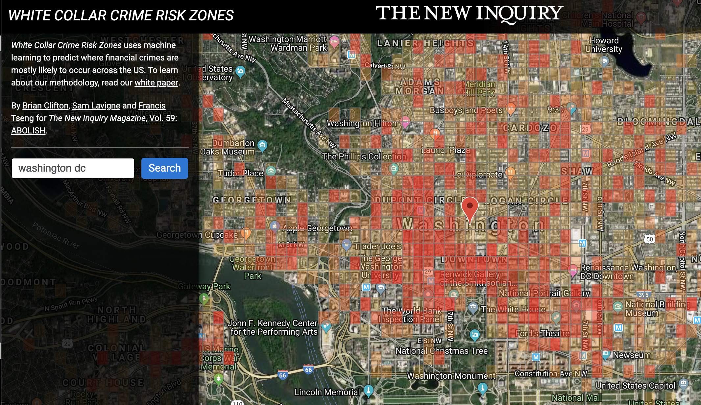
Notes:
https://whitecollar.thenewinquiry.com/
https://whitecollar.thenewinquiry.com/static/whitepaper.pdf
Turning the tables on predictive policing

Slide 43
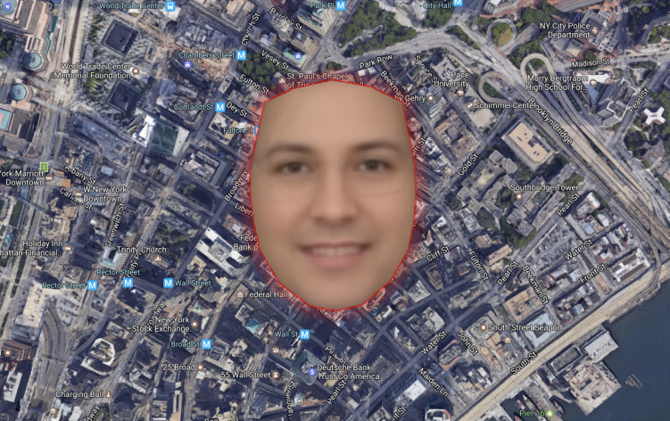
Notes:
The authors also helpfully provide a composite face of the perpetrators of financial crime, so you can keep a look out

Slide 44
… in Migration
Where will ICE look for you?
Do your social media postings align with ICE criteria?
Will you pass “extreme vetting?”

Slide 45
… in Social Services
Are you likely to abuse or neglect your children?
Do you deserve housing?
Have you committed “welfare fraud”?
Notes:
Will you exchange your privacy for this benefit?

Slide 46
… on the street
Will this store’s door open for you?
Will this autonomous vehicle stop for you?

Slide 47
… in our Democracy
Which news stories will you see?
Will your name be purged from voter lists?

Slide 48
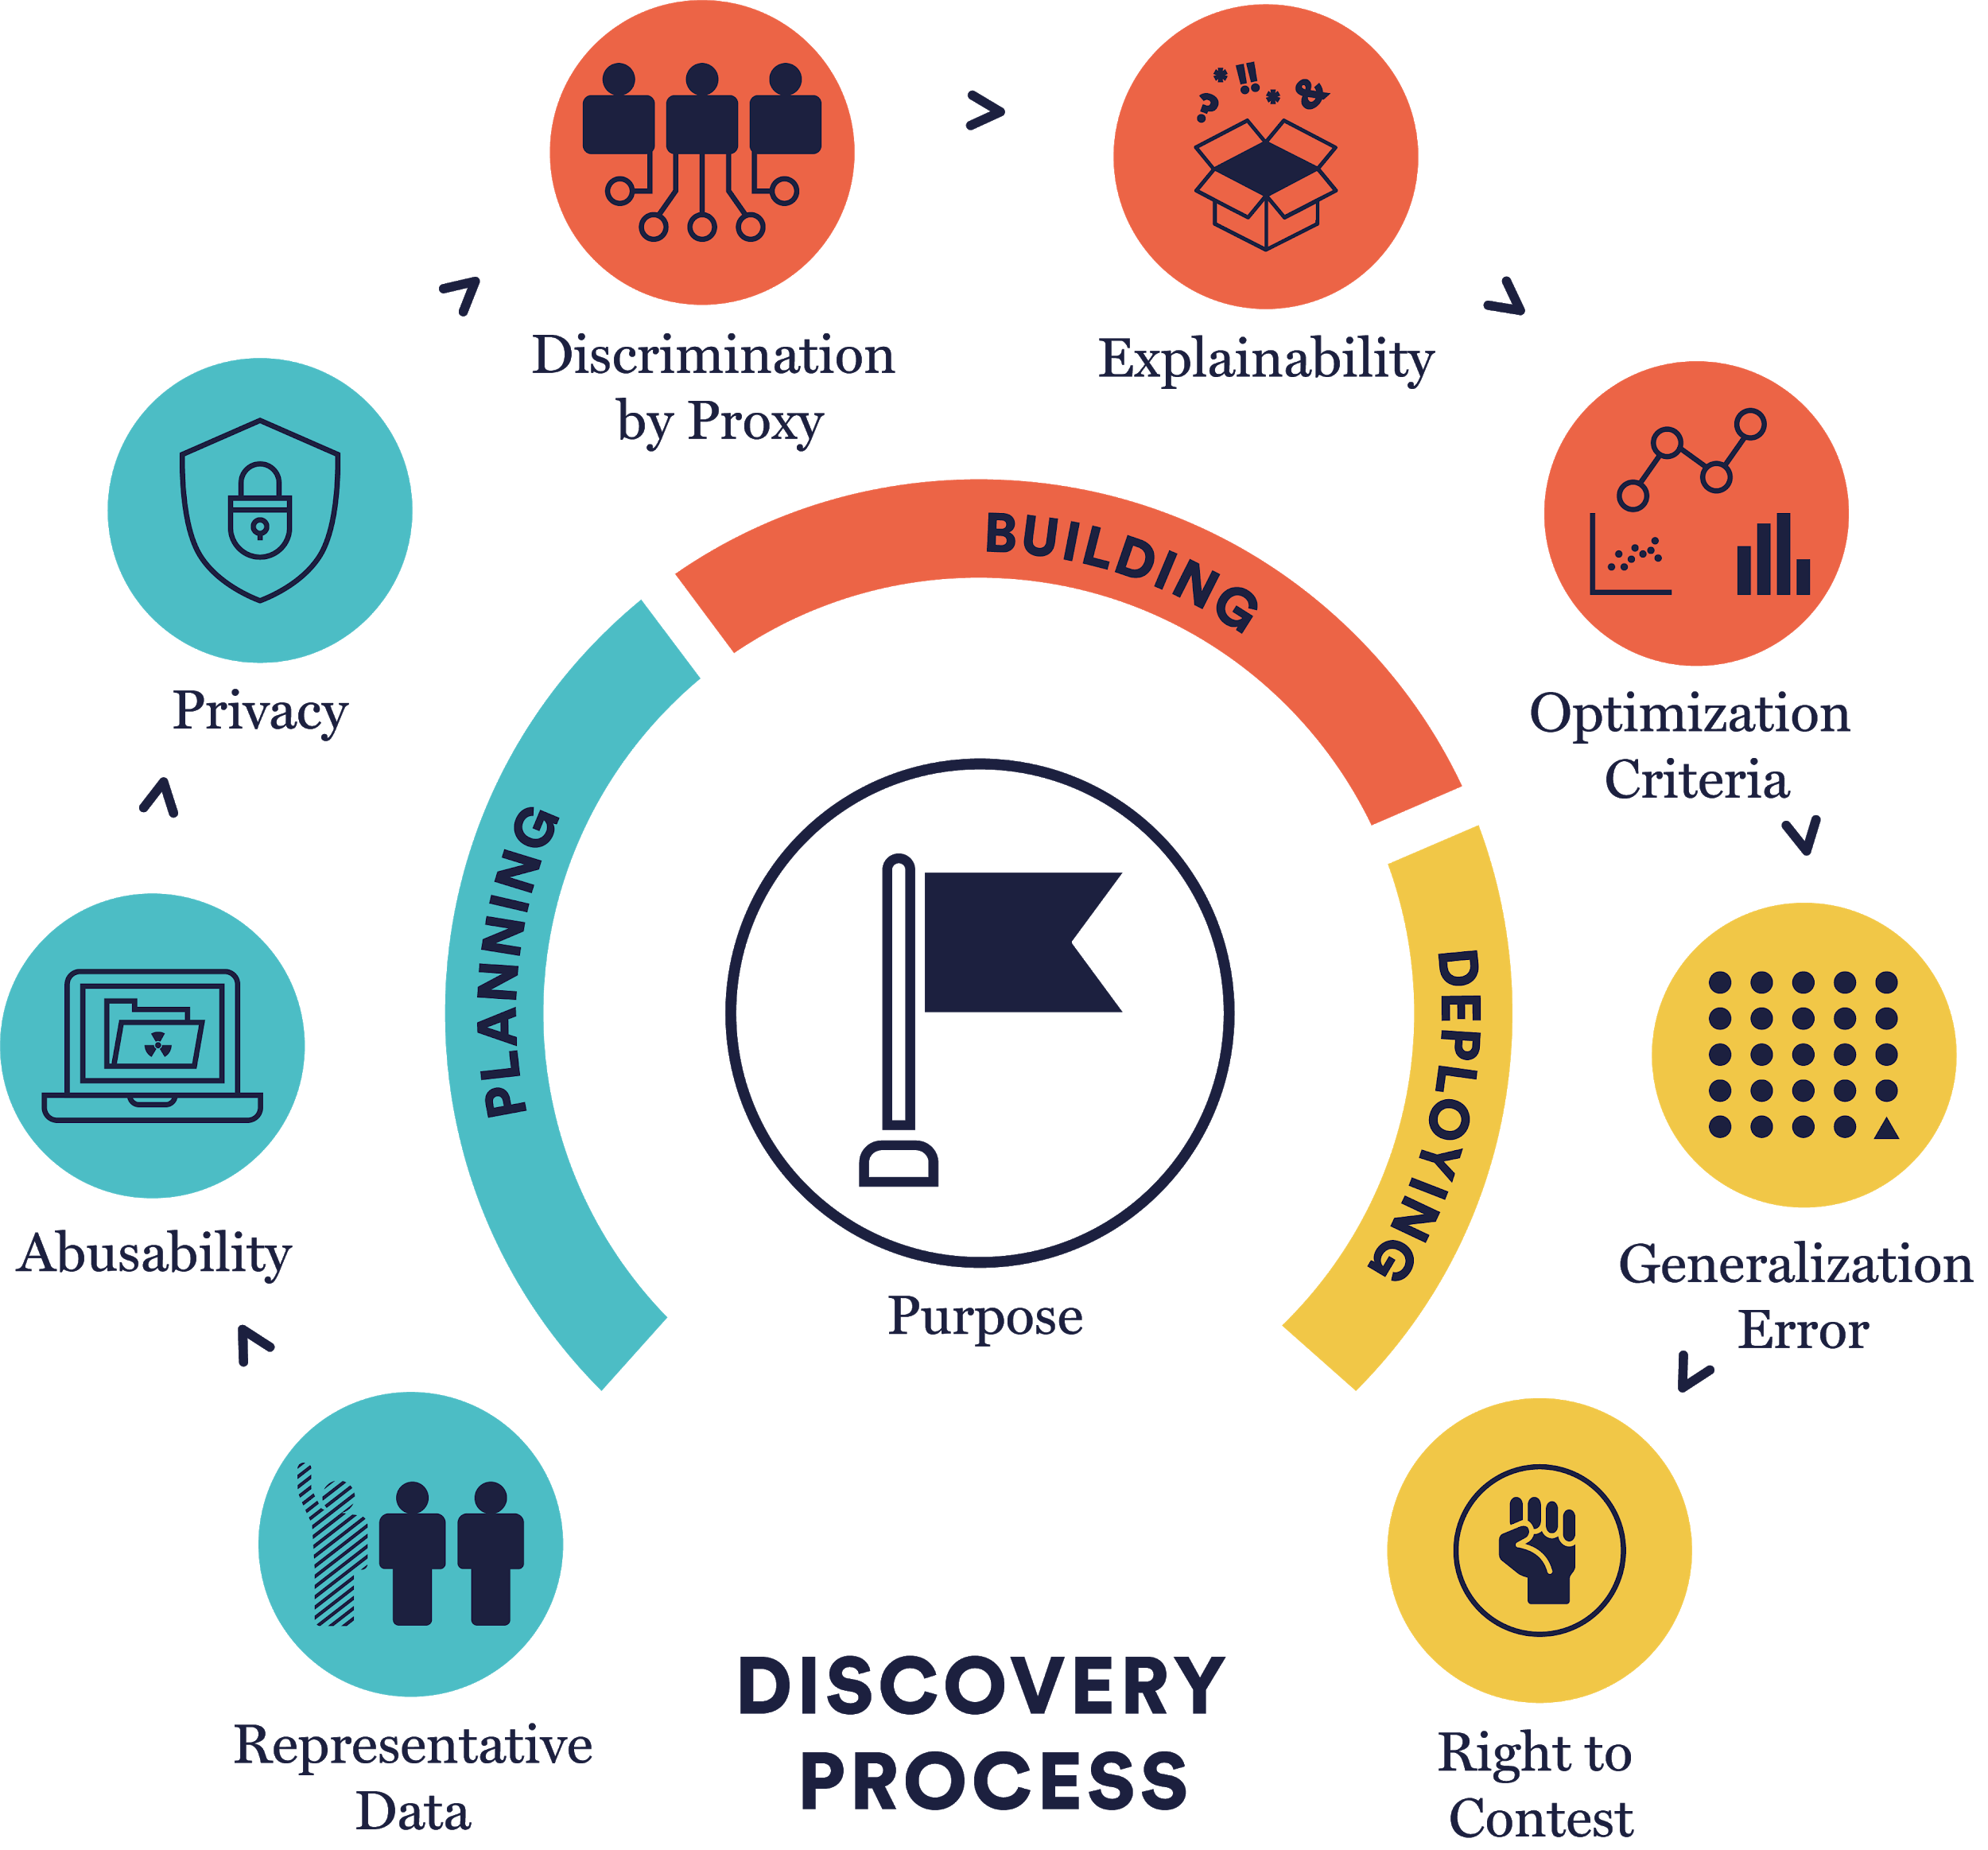
Notes:
http://aiblindspot.media.mit.edu/index.html

Slide 49
Acknowledgements
MIT’s AI Blindspot
Stanford’s AI Lab (SAIL) Blog
Princeton Dialogue on AI & Ethics
Slides Carnival

